Slide 1
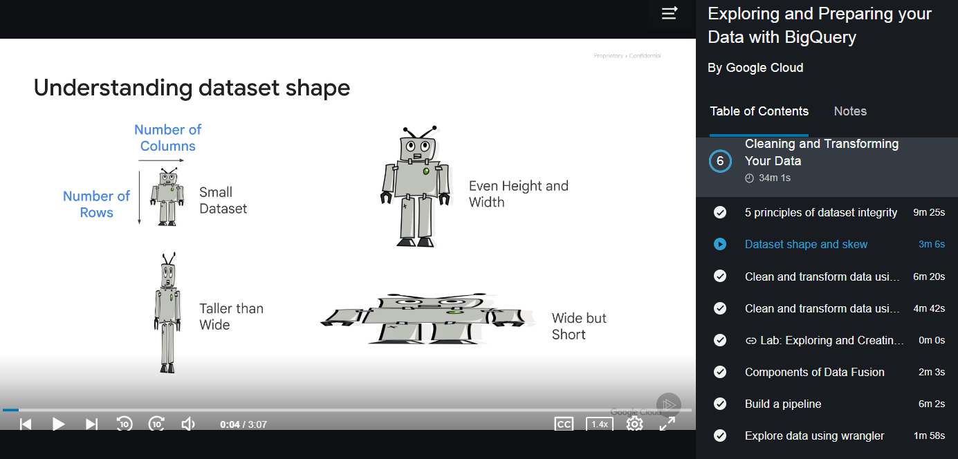
Multi Param JDBC Template

Slide 2
Multi Param JDBC Template
Typical Hibernate Annotation:
@Query("select new example.DataCollector(
s.server, a.app,i.instance)
from AXS x join Server s on x.server = s.server
join Application a on x.app = a.app
join Instance i on x.instance = i.instance
where s.server LIKE ?1%" )
public List<DataCollector> findAllData();

Slide 3
Multi Param JDBC Template
SQL Template:
select * from data where id in (?,?,?,?,?) and key in (?,?,?)

Slide 4
Multi Param JDBC Template
Request Param:
curl -X POST
-d "key=example+1,example+2&id=1,2,3,4,5,6" 127.0.0.1:8080/test/query
curl -X POST
-d "key=example+1&key=example+2&id=1&id=2&id=3&id=4&id=5&id=6" 127.0.0.1:8080/test/query

Slide 5
Multi Param JDBC Template
Java Code:
public List<Data> query(List<Integer> ids, List<String> keys){
int idSize = ids.size();
List<Object> args = new ArrayList<>();
String questionmarks[] = new String[idSize];
Arrays.fill(questionmarks, "?");
args.addAll(ids);
// flatten args into array
String SQL = "SELECT * FROM DATA WHERE id IN (" +
join(",", questionmarks ) + ")" + ...
args.addAll(idSize, keys);
...
return jdbcTemplate.query(SQL, args.toArray(),
new DataMapper());

Slide 6
Multi Param JDBC Template
Java Code:
Class.forName("org.postgresql.Driver");
pstmt = DriverManager.getConnection(URL, USER, PASSWORD)
.prepareStatement(
"select id from data where id in (%s)",
join(",", questionmarks);
int cnt = 1; for (int id : ids)
pstmt.setInt(cnt++, id);
rs = pstmt.executeQuery();
wile (rs.next())
results.add(rs.getInt("id"));

Slide 7
Multi Param JDBC Template
Runtime Error:
org.springframework.jdbc.BadSqlGrammarException:
org.postgresql.util.PSQLException
ERROR: operator does not exist: integer = character varying
Hint: No operator matches the given name and argument types.

Slide 8
Multi Param JDBC Template
Vendor-specific workaround: PostgreSQL (YugaByte):
public List<BackendData> querySimilarTo(List<String> keys) {
return jdbcTemplate.query("SELECT * FROM DATA WHERE key SIMILAR TO ?",
new String[] { String.format("(%s)", String.join("|", keys)) },
new BackendDataMapper());

Slide 9
Multi Param JDBC Template
Vendor-specific workaround: MySQL:
public List<BackendData> queryRegexpOfSetKeys(List<String> keys) {
return jdbcTemplate.query("SELECT * FROM DATA WHERE `key` REGEXP ?",
new String[] { String.format("(%s)", String.join("|", keys)) },
new BackendDataMapper());

